Slide 1
Chapter 12
Automate and Enable Low-Risk Releases
Group 6 – Lauren Thorne and Theophilus Nwea-Miah

Slide 2
Introduction
Facebook example of deployment
Code deployment should be a part of daily work
How to reduce friction in product deployments
Deployment should be on demand or automatic once product passes all the tests
Examples of different practices.
Notes:
Facebook – realized that for more changes more deployments are needed. Went from weekly to 3 times daily.

Slide 3
Automate Our Deployment process
Steps for deployment should be thoroughly documented
Simplify and automate as much as possible
Reduce lead time and handoffs
Deployment pipeline requirements
Deploy the same way to every environment
Smoke test deployments
Ensure we maintain consistent environments
CSG International Case Study
Notes:
First we need to have an automated mechanism to deploy code into production. Whatever the current process for deployment is, it needs to be thoroughly documented similar to value stream mapping. Then, we need to simplify or automate every manual step that we can in that process such as packaging code, cre ating pre-configured virtual machines. Copying files to servers, running smoke tests and test procedures, etc. We also want to reduce lead time and any unnecessary hand offs to reduce the possibility of errors.
In doing this, there are some requirement for the deployment Pipeling

Slide 4
Enable Automated Self-service Deployments
Shift way of deployment to automation
Code promotions should be able to be processed by Development or Operations impacting:
Building
Testing
Deployment
Notes:
We have moved away from the early days when a developer could release their code as soon as it was done and immediately see it in action and get feedback from clients. Things shifted to Operations being the ones to do the deployment, likely because of security or compliance regulations. However, with DevOps we want to relay on the automations instead of waiting for the Operations tea, .

Slide 5
Integrate Code Deployment into the Deployment Pipeline
Ensure packages are suitable for deployment into production
Show readiness of production environment
Give push-button for code to be deployed
Automatically record what was run, when, who authorized it, and what the output was
Run a smoke test to make sure the system is operations correcting and the configurations setting are correct
Provide fast feedback to deployer to determine success
Case Study – Etsy
Notes:
Once deployment is automated it can be a part of the deployment pipeline. It must provide the following capabilities

Slide 6
Decouple Deployments from Releases
Separate deployment and release
Two broad categories of release patterns:
Environment-based release patterns
Application –based release patters
Notes:
Deployment is the installation of a specified version of software to an environment. Release is when a feature is available to customers and doesn’t require changing application code.

Slide 7
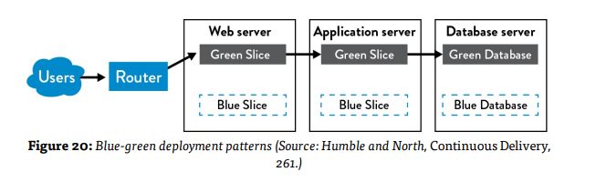
The Blue-Green Deployment Pattern

Slide 8
Dealing with Database Changes
How to resolve issues with two versions of the application in production:
Create two databases
Decouple database changes from application changes
Case Study: Dixons Retail

Slide 9
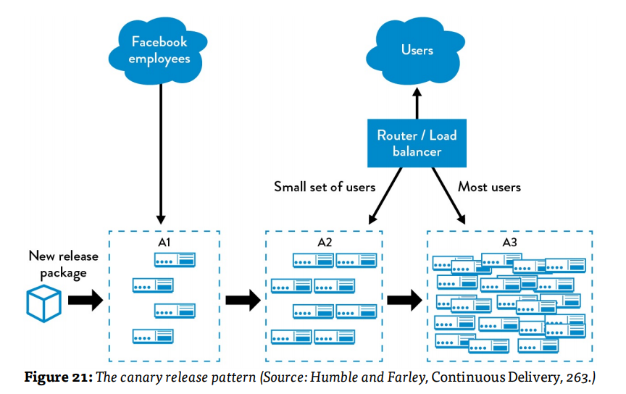
The Canary and Cluster Immune System Release Patterns

Slide 10
Application-Based Patterns to Enable Safer Releases
Implement Feature Toggles
Roll back easily
Gracefully degrade performance
Increase resilience through service-oriented architecture
Perform Dark Launches
Case Study: Dark Launch of Facebook Chat

Slide 11

Survey of Continuous Delivery and Continuous Deployment in Practice
Continuous delivery vs continuous deployment

Slide 12
Conclusion
Releases and deployments should not be stressful events that happen occaisionally
They should be a part of our everyday routine and be low-risk
Benefits:
Reduce deployment lead time
Deliver product with little disruption
Less stress Operations

